Slide 1
Generative Models
Gunnvant Saini

Slide 2
Agenda
Multinomial Generative Models
Example
Model Formulation
Estimation
Prediction
Gaussian Generative Models
Model Formulation
Example
Estimation
Prediction

Slide 3
Multinomial Generative Models
Mostly used when you are doing text or any kind of sequence classification.

Slide 4
Multinomial Generative Model: Example
Stackoverflow Question | Category
Why lists in python are not immutable? | Python
How to handle threads in Java 8? | Java
In python how to handle concurrency? | Python
…. | Java
… | Python

Slide 5
Multinomial Generative Model: Example
Stackoverflow Question | Category
Why lists in python are not immutable? | Python
How to handle threads in Java 8? | Java
In python how to handle concurrency? | Python
…. | Java
… | Python
To be predicted (y)

Slide 6
Multinomial Generative Model: Example
Stackoverflow Question | Category
Why lists in python are not immutable? | Python
How to handle threads in Java 8? | Java
In python how to handle concurrency? | Python
…. | Java
… | Python
Predictors
To be predicted (y)

Slide 7
Multinomial Generative Model: Model Formulation
Stackoverflow Question | Category
Why lists in python are not immutable? | Python
How to handle threads in Java 8? | Java
In python how to handle concurrency? | Python
…. | Java
… | Python
Predictors
To be predicted (y)
'8', 'handle', 'in', 'threads', 'how', 'to', 'java', 'lists', 'python', 'immutable', 'are', 'concurrency', 'not', 'why'

Slide 8
Multinomial Generative Model: Model Formulation
Stackoverflow Question | Category
Why lists in python are not immutable? | Python
How to handle threads in Java 8? | Java
In python how to handle concurrency? | Python
…. | Java
… | Python
Predictors
To be predicted (y)
'8', 'handle', 'in', 'threads', 'how', 'to', 'java', 'lists', 'python', 'immutable', 'are', 'concurrency', 'not', 'why'
Vocabulary (W)

Slide 9
Multinomial Generative Model: Model Formulation
'8', 'handle', 'in', 'threads', 'how', 'to', 'java', 'lists', 'python', 'immutable', 'are', 'concurrency', 'not', 'why'
Vocabulary (W)
$$P\left(handle\right), P\left(in\right), P\left(threads\right), P\left(how\right)…P(why)$$
$$P\left(handle\right), P\left(in\right), P\left(threads\right), P\left(how\right)…P(why)$$

Slide 10
Multinomial Generative Model: Model Formulation
'8', 'handle', 'in', 'threads', 'how', 'to', 'java', 'lists', 'python', 'immutable', 'are', 'concurrency', 'not', 'why'
Vocabulary (W)
$$P\left(handle\right), P\left(in\right), P\left(threads\right), P\left(how\right)…P(why)$$
python
$$P\left(handle\right), P\left(in\right), P\left(threads\right), P\left(how\right)…P(why)$$
java

Slide 11
Multinomial Generative Model: Model Formulation
'8', 'handle', 'in', 'threads', 'how', 'to', 'java', 'lists', 'python', 'immutable', 'are', 'concurrency', 'not', 'why'
Vocabulary (W)
$$P\left(handle\right), P\left(in\right), P\left(threads\right), P\left(how\right)…P(why)$$
python
$$P\left(handle\right), P\left(in\right), P\left(threads\right), P\left(how\right)…P(why)$$
java
Sent = The sets in python are immutable.

Slide 12
Multinomial Generative Model: Model Formulation
'8', 'handle', 'in', 'threads', 'how', 'to', 'java', 'lists', 'python', 'immutable', 'are', 'concurrency', 'not', 'why'
Vocabulary (W)
$$P\left(handle\right), P\left(in\right), P\left(threads\right), P\left(how\right)…P(why)$$
python
$$P\left(handle\right), P\left(in\right), P\left(threads\right), P\left(how\right)…P(why)$$
java
Sent = The sets in python are immutable. = {the, sets, in, python, are, immutable}

Slide 13


Multinomial Generative Model: Model Formulation
'8', 'handle', 'in', 'threads', 'how', 'to', 'java', 'lists', 'python', 'immutable', 'are', 'concurrency', 'not', 'why'
Vocabulary (W)
$$P\left(handle\right), P\left(in\right), P\left(threads\right), P\left(how\right)…P(why)$$
python
$$P\left(handle\right), P\left(in\right), P\left(threads\right), P\left(how\right)…P(why)$$
java
Sent = The sets in python are immutable. = {the, sets, in, python, are, immutable}
$$P\left(Sent | python\right)=∏P_{w}^{count\left(w\right)} ∀ w∈W$$
$$P\left(Sent | java\right)=∏P_{w^{′}}^{count\left(w^{′}\right)} ∀ w′∈W$$

Slide 14
Multinomial Generative Model: Estimation
'8', 'handle', 'in', 'threads', 'how', 'to', 'java', 'lists', 'python', 'immutable', 'are', 'concurrency', 'not', 'why'
Vocabulary (W)
$$P\left(handle\right), P\left(in\right), P\left(threads\right), P\left(how\right)…P(why)$$
python
$$P\left(handle\right), P\left(in\right), P\left(threads\right), P\left(how\right)…P(why)$$
java
These have to be estimated

Slide 15


Multinomial Generative Model: Estimation (Binary Vocabulary)
$$w_{1},w_{2}$$
Vocabulary (W)
$$P\left(w_{1}\right),1−P\left(w_{1}\right)=θ_{1},1−θ_{1}$$
Class 1
$$P\left(w_{1}\right),1−P\left(w_{1}\right)={θ′}_{1},1−{θ′}_{1}$$
Class 2
These have to be estimated

Slide 16
Multinomial Generative Model: Estimation (Binary Vocabulary)
$$w_{1},w_{2}$$
Vocabulary (W)
S1 = w1w2w1w2
S2 = w2w2w1w2
S3 = w1w1w2w2w1
…
…
Sn= w1w1w2w2w1w1

Slide 17
Multinomial Generative Model: Estimation (Binary Vocabulary)
$$w_{1},w_{2}$$
Vocabulary (W)
S1 = w1w2w1w2
S2 = w2w2w1w2
S3 = w1w1w2w2w1
…
…
Sn= w1w1w2w2w1w1
$$P\left(w_{1}\right),1−P\left(w_{1}\right)=θ_{1},1−θ_{1}$$
Class 1

Slide 18
Multinomial Generative Model: Estimation (Binary Vocabulary)
$$w_{1},w_{2}$$
Vocabulary (W)
$$P\left(w_{1}\right),1−P\left(w_{1}\right)=θ_{1},1−θ_{1}$$
Class 1
S1 = w1w2w1w2
S2 = w2w2w1w2
S3 = w1w1w2w2w1
…
…
Sn= w1w1w2w2w1w1
w1w2w1w2
w2w2w1w2
w1w1w2w2w1
…
…
w1w1w2w2w1w1
Concatenate all the documents
Estimate the P(Corpus|Class)

Slide 19

Multinomial Generative Model: Estimation (Binary Vocabulary)
$$w_{1},w_{2}$$
Vocabulary (W)
$$P\left(w_{1}\right),1−P\left(w_{1}\right)=θ_{1},1−θ_{1}$$
Class 1
S1 = w1w2w1w2
S2 = w2w2w1w2
S3 = w1w1w2w2w1
…
…
Sn= w1w1w2w2w1w1
w1w2w1w2
w2w2w1w2
w1w1w2w2w1
…
…
w1w1w2w2w1w1
Concatenate all the documents
Estimate the P(Corpus|Class)
Use Maximum Likelihood for estimation
$$L\left(D|θ\right)=∏θ_{w}^{count\left(w\right)} ∀w∈\{w_{1},w_{2}\}$$

Slide 20

Multinomial Generative Model: Estimation (Binary Vocabulary)
$$w_{1},w_{2}$$
Vocabulary (W)
$$P\left(w_{1}\right),1−P\left(w_{1}\right)=θ_{1},1−θ_{1}$$
Class 1
S1 = w1w2w1w2
S2 = w2w2w1w2
S3 = w1w1w2w2w1
…
…
Sn= w1w1w2w2w1w1
w1w2w1w2
w2w2w1w2
w1w1w2w2w1
…
…
w1w1w2w2w1w1
Concatenate all the documents
Estimate the P(Corpus|Class)
Use Maximum Likelihood for estimation
$$max L\left(D|θ\right)= ∏θ_{w}^{count\left(w\right)} ∀w∈\{w_{1},w_{2}\}$$

Slide 21
Multinomial Generative Model: Estimation (Binary Vocabulary)
$$w_{1},w_{2}$$
Vocabulary (W)
$$P\left(w_{1}\right),1−P\left(w_{1}\right)=θ_{1},1−θ_{1}$$
Class 1
S1 = w1w2w1w2
S2 = w2w2w1w2
S3 = w1w1w2w2w1
…
…
Sn= w1w1w2w2w1w1
w1w2w1w2
w2w2w1w2
w1w1w2w2w1
…
…
w1w1w2w2w1w1
Concatenate all the documents
Estimate the P(Corpus|Class)
Use Maximum Likelihood for estimation
$$max log⁡(L\left(D|θ\right))=max log⁡(∏θ_{w}^{count\left(w\right)}) ∀w∈\{w_{1},w_{2}\}$$

Slide 22
Multinomial Generative Model: Estimation (Binary Vocabulary)
$$w_{1},w_{2}$$
Vocabulary (W)
$$P\left(w_{1}\right),1−P\left(w_{1}\right)=θ_{1},1−θ_{1}$$
Class 1
S1 = w1w2w1w2
S2 = w2w2w1w2
S3 = w1w1w2w2w1
…
…
Sn= w1w1w2w2w1w1
w1w2w1w2
w2w2w1w2
w1w1w2w2w1
…
…
w1w1w2w2w1w1
Concatenate all the documents
Estimate the P(Corpus|Class)
Use Maximum Likelihood for estimation
$$max log⁡(L\left(D|θ\right))=max ∑count\left(w\right)log⁡(θ_{w}) ∀w∈\{w_{1},w_{2}\}$$

Slide 23
Multinomial Generative Model: Estimation (Binary Vocabulary)
$$w_{1},w_{2}$$
Vocabulary (W)
$$P\left(w_{1}\right),1−P\left(w_{1}\right)=θ_{1},1−θ_{1}$$
Class 1
S1 = w1w2w1w2
S2 = w2w2w1w2
S3 = w1w1w2w2w1
…
…
Sn= w1w1w2w2w1w1
w1w2w1w2
w2w2w1w2
w1w1w2w2w1
…
…
w1w1w2w2w1w1
Concatenate all the documents
Estimate the P(Corpus|Class)
Use Maximum Likelihood for estimation
$$max\log\left(L\left(D|θ\right)\right)=\max{ }count\left(w_{1}\right)\log\left(θ_{1}\right)+count\left(w_{2}\right)log⁡(1−θ_{1}) ∀w∈\{w_{1},w_{2}\}$$

Slide 24
Multinomial Generative Model: Estimation (Binary Vocabulary)
$$w_{1},w_{2}$$
Vocabulary (W)
$$P\left(w_{1}\right),1−P\left(w_{1}\right)=θ_{1},1−θ_{1}$$
Class 1
S1 = w1w2w1w2
S2 = w2w2w1w2
S3 = w1w1w2w2w1
…
…
Sn= w1w1w2w2w1w1
w1w2w1w2
w2w2w1w2
w1w1w2w2w1
…
…
w1w1w2w2w1w1
Concatenate all the documents
Estimate the P(Corpus|Class)
Use Maximum Likelihood for estimation
$$\frac{∂\log\left(L\left(D|θ\right)\right)}{∂(θ)}=\frac{∂(count\left(w_{1}\right)\log\left(θ_{1}\right)+count\left(w_{2}\right)log⁡(1−θ_{1}))}{∂θ_{1}} ∀w∈\{w_{1},w_{2}\}$$

Slide 25
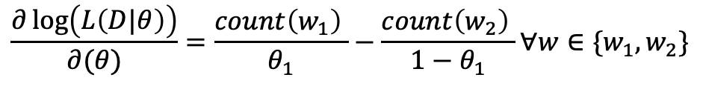
Multinomial Generative Model: Estimation (Binary Vocabulary)
$$w_{1},w_{2}$$
Vocabulary (W)
$$P\left(w_{1}\right),1−P\left(w_{1}\right)=θ_{1},1−θ_{1}$$
Class 1
S1 = w1w2w1w2
S2 = w2w2w1w2
S3 = w1w1w2w2w1
…
…
Sn= w1w1w2w2w1w1
w1w2w1w2
w2w2w1w2
w1w1w2w2w1
…
…
w1w1w2w2w1w1
Concatenate all the documents
Estimate the P(Corpus|Class)
Use Maximum Likelihood for estimation
$$\frac{∂\log\left(L\left(D|θ\right)\right)}{∂(θ)}=\frac{count\left(w_{1}\right) }{θ_{1}}−\frac{count\left(w_{2}\right) }{1−θ_{1}}∀w∈\{w_{1},w_{2}\}$$

Slide 26
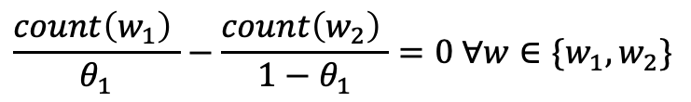
Multinomial Generative Model: Estimation (Binary Vocabulary)
$$w_{1},w_{2}$$
Vocabulary (W)
$$P\left(w_{1}\right),1−P\left(w_{1}\right)=θ_{1},1−θ_{1}$$
Class 1
S1 = w1w2w1w2
S2 = w2w2w1w2
S3 = w1w1w2w2w1
…
…
Sn= w1w1w2w2w1w1
w1w2w1w2
w2w2w1w2
w1w1w2w2w1
…
…
w1w1w2w2w1w1
Concatenate all the documents
Estimate the P(Corpus|Class)
Use Maximum Likelihood for estimation
$$\frac{count\left(w_{1}\right) }{θ_{1}}−\frac{count\left(w_{2}\right) }{1−θ_{1}}=0 ∀w∈\{w_{1},w_{2}\}$$

Slide 27
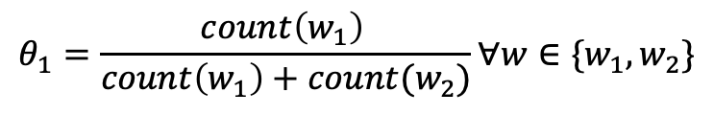
Multinomial Generative Model: Estimation (Binary Vocabulary)
$$w_{1},w_{2}$$
Vocabulary (W)
$$P\left(w_{1}\right),1−P\left(w_{1}\right)=θ_{1},1−θ_{1}$$
Class 1
S1 = w1w2w1w2
S2 = w2w2w1w2
S3 = w1w1w2w2w1
…
…
Sn= w1w1w2w2w1w1
w1w2w1w2
w2w2w1w2
w1w1w2w2w1
…
…
w1w1w2w2w1w1
Concatenate all the documents
Estimate the P(Corpus|Class)
Use Maximum Likelihood for estimation
$$θ_{1}=\frac{count\left(w_{1}\right) }{count\left(w_{1}\right)+count(w_{2})}∀w∈\{w_{1},w_{2}\}$$

Slide 28
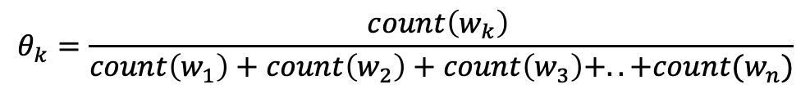

Multinomial Generative Model: Estimation (Non Binary Vocabulary)
$$w_{1},w_{2}, w_{3}, …, w_{n}$$
Vocabulary (W)
S1 = w1w2w1w2w4
S2 = w2w2w1w2wn
S3 = w1w1w2w2w1w6
…
…
Sn= w1w1w2w2w1w1w81
w1w2w1w2w4
w2w2w1w2wn
w1w1w2w2w1w6
…
…
w1w1w2w2w1w1w81
Concatenate all the documents
Estimate the P(Corpus|Class)
Use Maximum Likelihood for estimation
$$θ_{k}=\frac{count\left(w_{k}\right) }{count\left(w_{1}\right)+count\left(w_{2}\right)+count\left(w_{3}\right)+..+count(w_{n})}$$

Slide 29
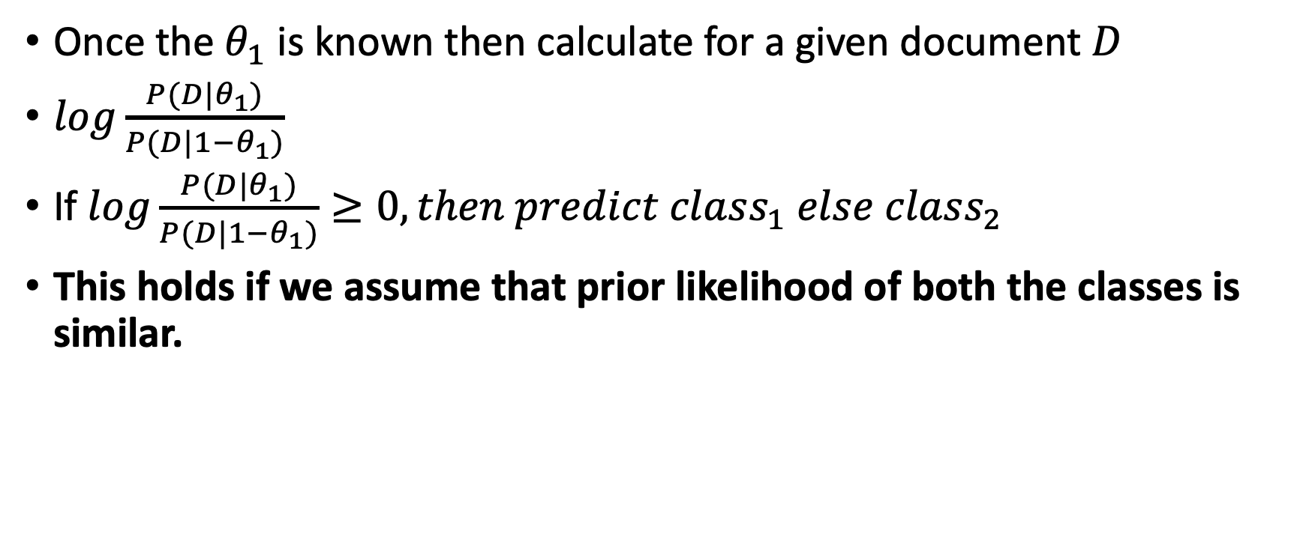
Multinomial Generative Model: Prediction
Once the $θ_{1}$ is known then calculate for a given document $D$
$log\frac{P(D|θ_{1})}{P(D|1−θ_{1})}$
If $log\frac{P(D|θ_{1})}{P(D|1−θ_{1})}≥0, then predict class_{1} else class_{2}$
This holds if we assume that prior likelihood of both the classes is similar.

Slide 30
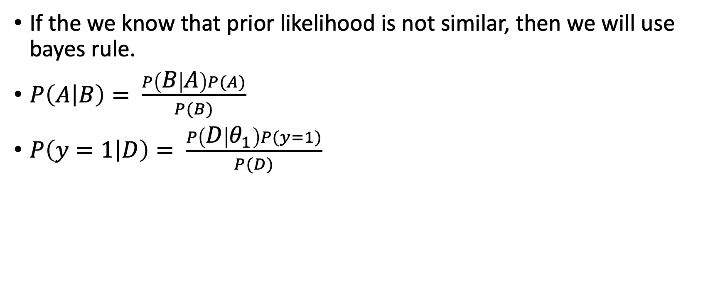
Multinomial Generative Model: Prediction
If the we know that prior likelihood is not similar, then we will use bayes rule.
$P\left(A | B\right)= \frac{P\left(B | A\right)P(A)}{P(B)}$
$P\left(y=1 | D\right)= \frac{P\left(D | θ_{1}\right)P(y=1)}{P(D)}$

Slide 31
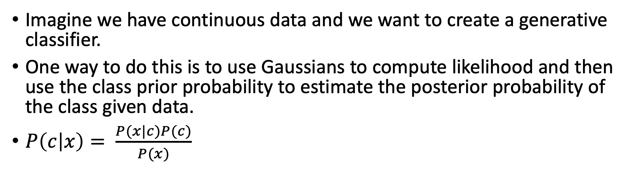
Gaussian Generative Models: Model Formulation
Imagine we have continuous data and we want to create a generative classifier.
One way to do this is to use Gaussians to compute likelihood and then use the class prior probability to estimate the posterior probability of the class given data.
$P\left(c | x\right)= \frac{P(x|c)P(c)}{P(x)}$

Slide 32
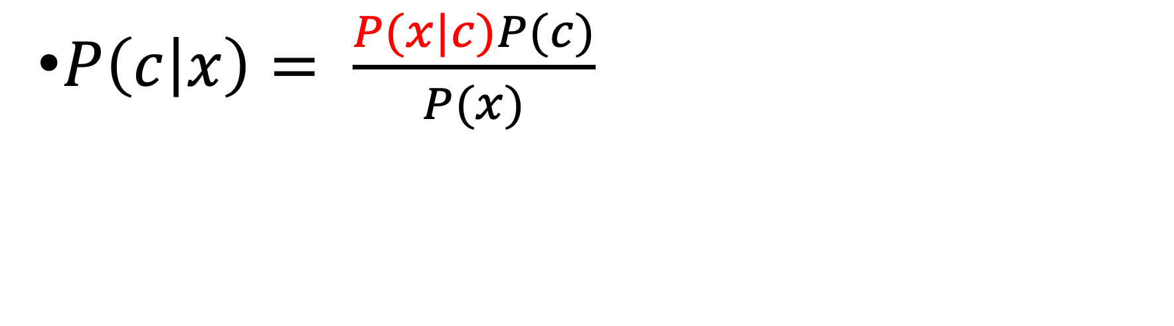
Gaussian Generative Models: Model Formulation
$P\left(c | x\right)= \frac{P(x|c)P(c)}{P(x)}$

Slide 33
Gaussian Generative Models: Model Formulation
$P\left(c | x\right)= \frac{P(x|c)P(c)}{P(x)}$
Estimated from a Gaussian Model

Slide 34
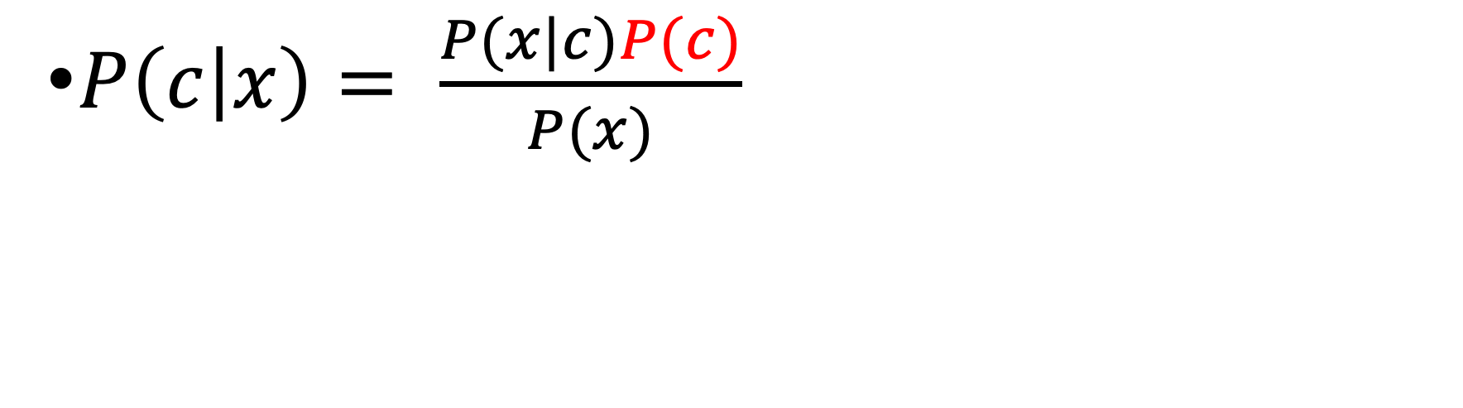
Gaussian Generative Models: Model Formulation
$P\left(c | x\right)= \frac{P(x|c)P(c)}{P(x)}$

Slide 35
Gaussian Generative Models: Model Formulation
$P\left(c | x\right)= \frac{P(x|c)P(c)}{P(x)}$
Prior, estimated either from training data or reflects subjective beliefs

Slide 36
Gaussian Generative Models: Example
Blood Sugar | Diabetic
10 | 0
8 | 0
10 | 0
10 | 0
11 | 0
11 | 0
12 | 1
9 | 1
15 | 1
10 | 1
13 | 1
13 | 1

Slide 37
Gaussian Generative Models: Example
Blood Sugar | Diabetic
10 | 0
8 | 0
10 | 0
10 | 0
11 | 0
11 | 0
12 | 1
9 | 1
15 | 1
10 | 1
13 | 1
13 | 1
10
11
06

Slide 38
Gaussian Generative Models: Example
Blood Sugar | Diabetic
10 | 0
8 | 0
10 | 0
10 | 0
11 | 0
11 | 0
12 | 1
9 | 1
15 | 1
10 | 1
13 | 1
13 | 1
10 | ?
11 | ?
06 | ?

Slide 39
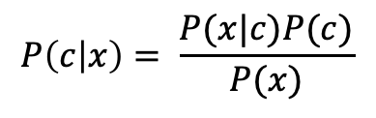
Gaussian Generative Models: Estimation
Blood Sugar | Diabetic
10 | 0
8 | 0
10 | 0
10 | 0
11 | 0
11 | 0
12 | 1
9 | 1
15 | 1
10 | 1
13 | 1
13 | 1
$$P\left(c | x\right)= \frac{P(x|c)P(c)}{P(x)}$$

Slide 40
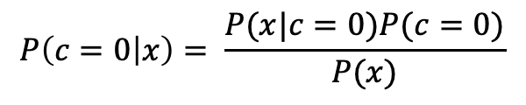
Gaussian Generative Models: Estimation
Blood Sugar | Diabetic
10 | 0
8 | 0
10 | 0
10 | 0
11 | 0
11 | 0
12 | 1
9 | 1
15 | 1
10 | 1
13 | 1
13 | 1
$$P\left(c | x\right)= \frac{P(x|c)P(c)}{P(x)}$$
$$P\left(c=0 | x\right)= \frac{P(x|c=0)P(c=0)}{P(x)}$$

Slide 41
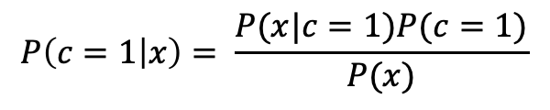
Gaussian Generative Models: Estimation
Blood Sugar | Diabetic
10 | 0
8 | 0
10 | 0
10 | 0
11 | 0
11 | 0
12 | 1
9 | 1
15 | 1
10 | 1
13 | 1
13 | 1
$$P\left(c | x\right)= \frac{P(x|c)P(c)}{P(x)}$$
$$P\left(c=0 | x\right)= \frac{P(x|c=0)P(c=0)}{P(x)}$$
$$P\left(c=1 | x\right)= \frac{P(x|c=1)P(c=1)}{P(x)}$$

Slide 42
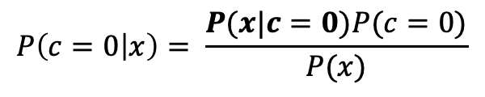
Gaussian Generative Models: Estimation
Blood Sugar | Diabetic
10 | 0
8 | 0
10 | 0
10 | 0
11 | 0
11 | 0
12 | 1
9 | 1
15 | 1
10 | 1
13 | 1
13 | 1
$$P\left(c | x\right)= \frac{P(x|c)P(c)}{P(x)}$$
$$P\left(c=0 | x\right)= \frac{P(x|c=0)P(c=0)}{P(x)}$$
$$P\left(c=1 | x\right)= \frac{P(x|c=1)P(c=1)}{P(x)}$$

Slide 43
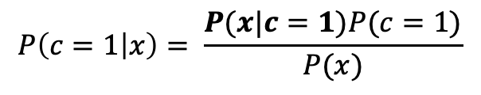
Gaussian Generative Models: Estimation
Blood Sugar | Diabetic
10 | 0
8 | 0
10 | 0
10 | 0
11 | 0
11 | 0
12 | 1
9 | 1
15 | 1
10 | 1
13 | 1
13 | 1
$$P\left(c | x\right)= \frac{P(x|c)P(c)}{P(x)}$$
$$P\left(c=0 | x\right)= \frac{P(x|c=0)P(c=0)}{P(x)}$$
$$P\left(c=1 | x\right)= \frac{P(x|c=1)P(c=1)}{P(x)}$$

Slide 44
Gaussian Generative Models: Estimation
Blood Sugar | Diabetic
10 | 0
8 | 0
10 | 0
10 | 0
11 | 0
11 | 0
12 | 1
9 | 1
15 | 1
10 | 1
13 | 1
13 | 1
$$P\left(c | x\right)= \frac{P(x|c)P(c)}{P(x)}$$
$$P\left(c=0 | x\right)= \frac{P(x|c=0)P(c=0)}{P(x)}$$
$$P\left(c=1 | x\right)= \frac{P(x|c=1)P(c=1)}{P(x)}$$

Slide 45
Gaussian Generative Models: Estimation
Blood Sugar | Diabetic
10 | 0
8 | 0
10 | 0
10 | 0
11 | 0
11 | 0
12 | 1
9 | 1
15 | 1
10 | 1
13 | 1
13 | 1
$$P\left(c | x\right)= \frac{P(x|c)P(c)}{P(x)}$$
$$P\left(c=0 | x\right)= \frac{P(x|c=0)P(c=0)}{P(x)}$$
$$P\left(c=1 | x\right)= \frac{P(x|c=1)P(c=1)}{P(x)}$$

Slide 46
Gaussian Generative Models: Estimation
Blood Sugar | Diabetic
10 | 0
8 | 0
10 | 0
10 | 0
11 | 0
11 | 0
12 | 1
9 | 1
15 | 1
10 | 1
13 | 1
13 | 1
$$P\left(c | x\right)= \frac{P(x|c)P(c)}{P(x)}$$
$$P\left(c=0 | x\right)= \frac{P(x|c=0)P(c=0)}{P(x)}$$
$$P\left(c=1 | x\right)= \frac{P(x|c=1)P(c=1)}{P(x)}$$
Estimated using Gaussian Distribution

Slide 47
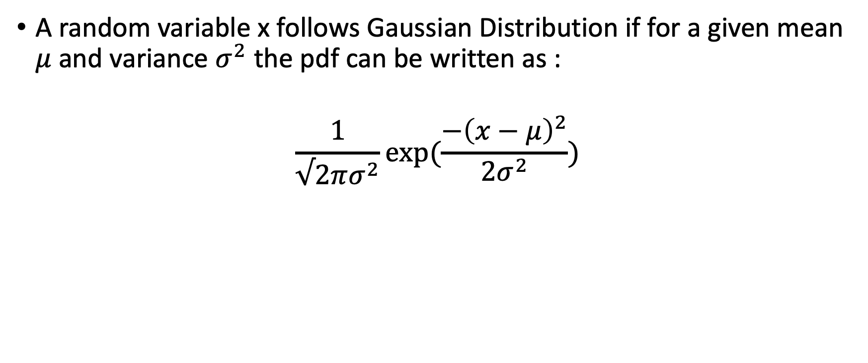
Gaussian Generative Models: Estimation
A random variable x follows Gaussian Distribution if for a given mean $μ$ and variance $σ^{2}$ the pdf can be written as :
$$\frac{1}{√2πσ^{2}}exp⁡(\frac{−{\left(x−μ\right)}^{2}}{2σ^{2}})$$

Slide 48
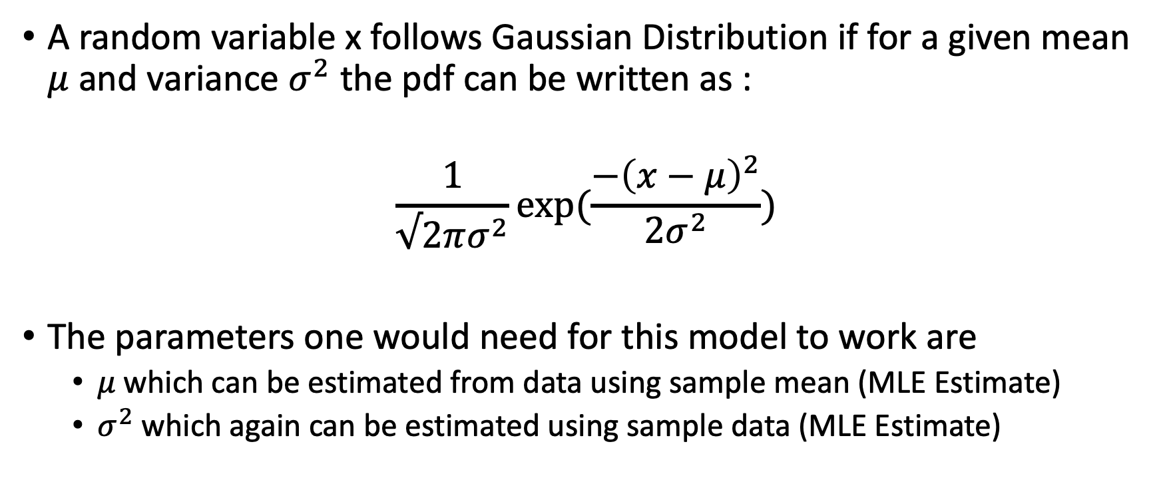
Gaussian Generative Models: Estimation
A random variable x follows Gaussian Distribution if for a given mean $μ$ and variance $σ^{2}$ the pdf can be written as :
$$\frac{1}{√2πσ^{2}}exp⁡(\frac{−{\left(x−μ\right)}^{2}}{2σ^{2}})$$
The parameters one would need for this model to work are
$μ$which can be estimated from data using sample mean (MLE Estimate)
$σ^{2}$ which again can be estimated using sample data (MLE Estimate)

Slide 49
Gaussian Generative Models: Prediction
Refer to the excel workbook “numerical_examples.xlsx” and the python notebook called “Lecture15.ipynb”

